Slide 2
Agentes: Un nuevo paradigma BC friendly

Slide 5


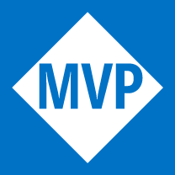



LOS COPILOTOS DE LA SESIÓN
TONI GRANELL
Microsoft Bizz Apps MVP & MVS
DQS & Nextraining Microsoft Ambassador
IAMCP Spain Regional Director Baleares
Administrador Global Communities: AI & Low Code
https://www.linkedin.com/in/tgranell/
https://www.meetup.com/es-ES/ai-low-code/
RAMÓN RAUTENSTRAUCH
Microsoft Copilot MVP 🤯.
Apasionado ❤️ del Marketing & CMO 😍.
Evangelista Copilot 🤖.
Consultor de IA y Dynamics 365 😍.
Friki de la tecnología y de experimentar con la IA.
https://www.linkedin.com/in/ramonrautenstrauch/
https://www.consultor365.com/
https://twitter.com/ramonrauten

Slide 6
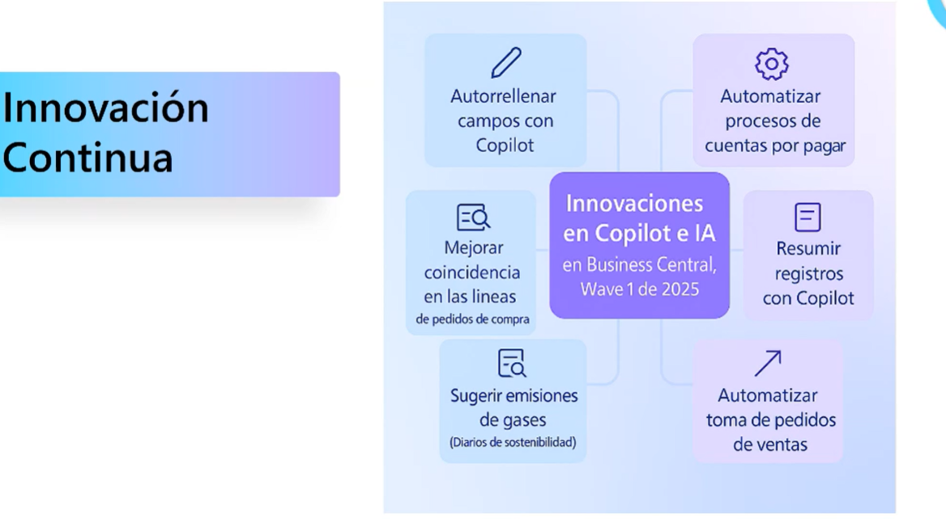

Slide 7
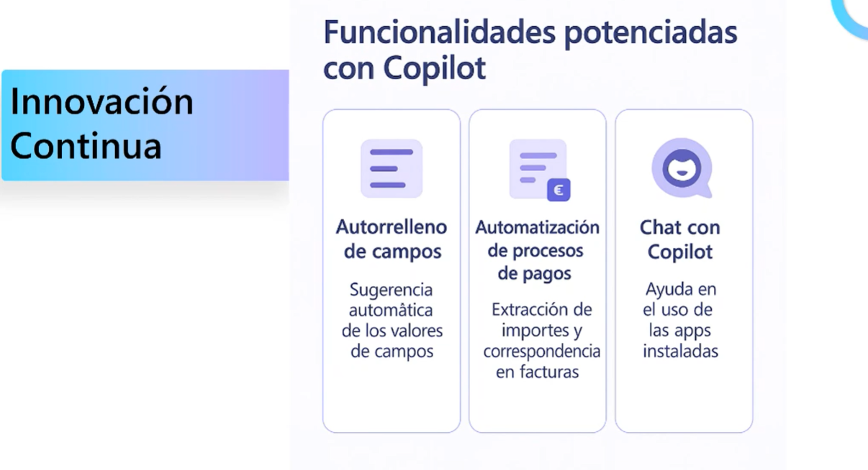

Slide 8
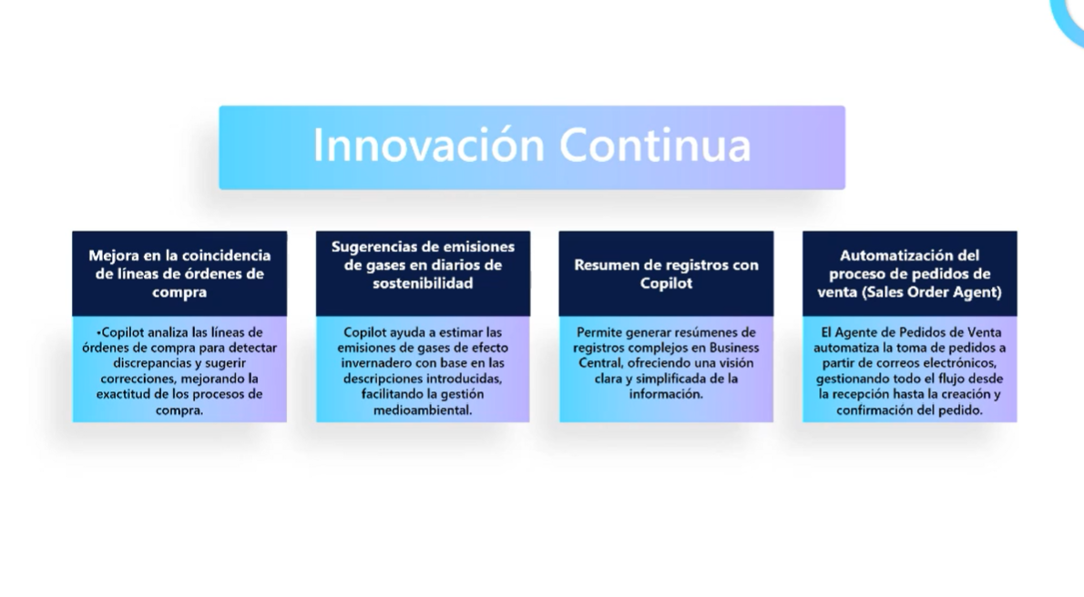

Slide 9
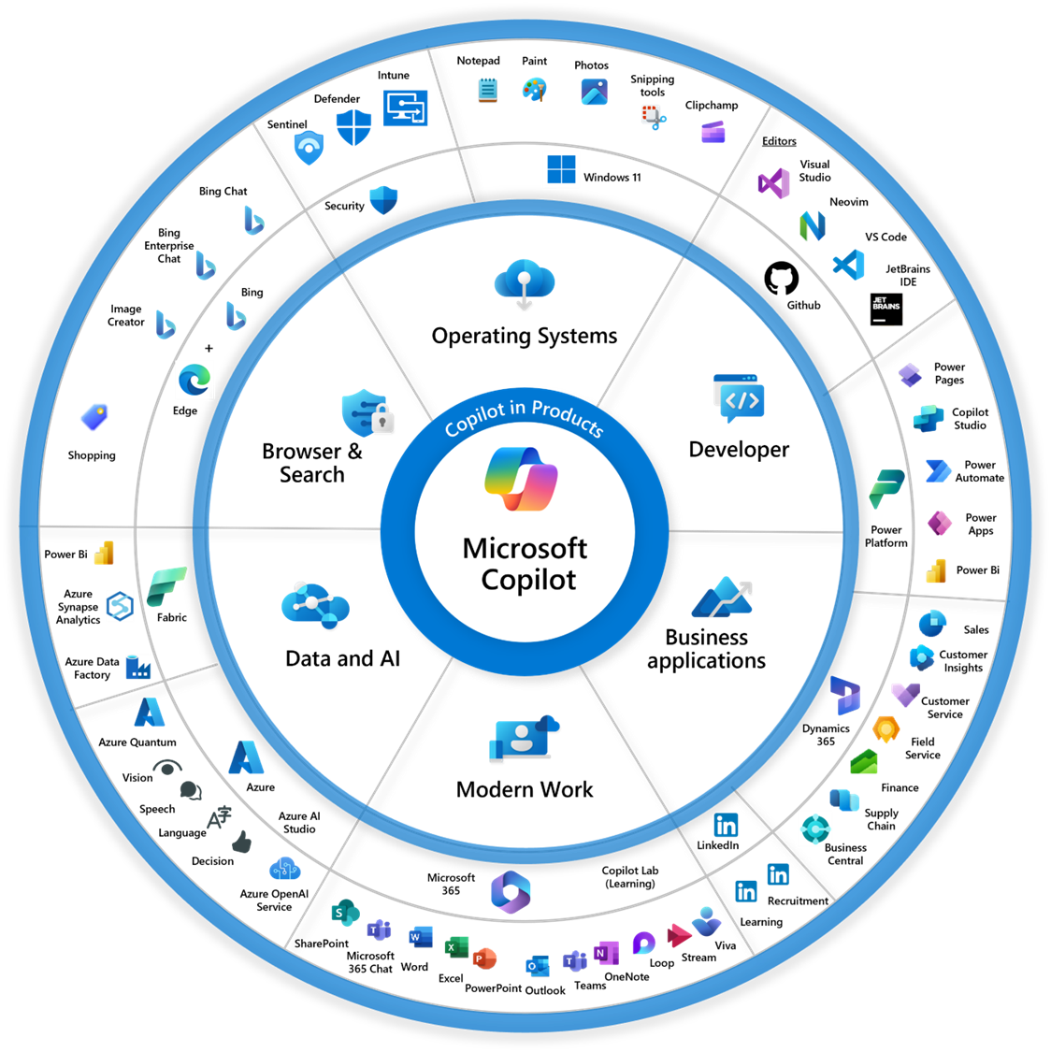

Slide 10
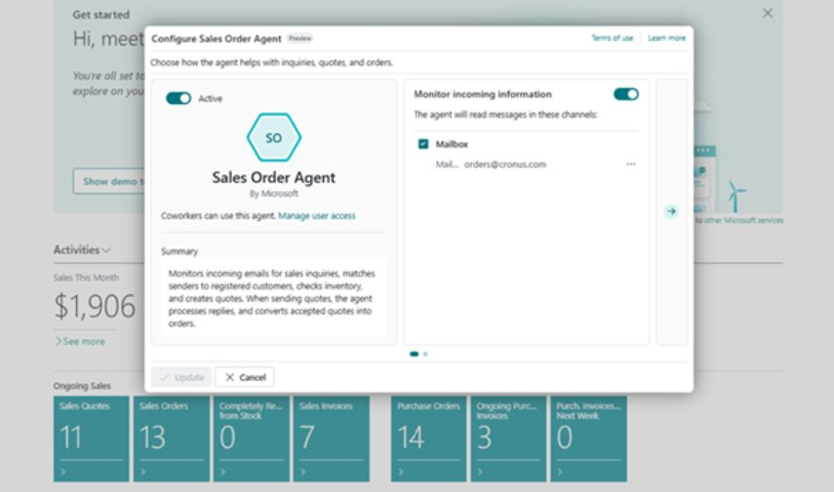

Slide 11
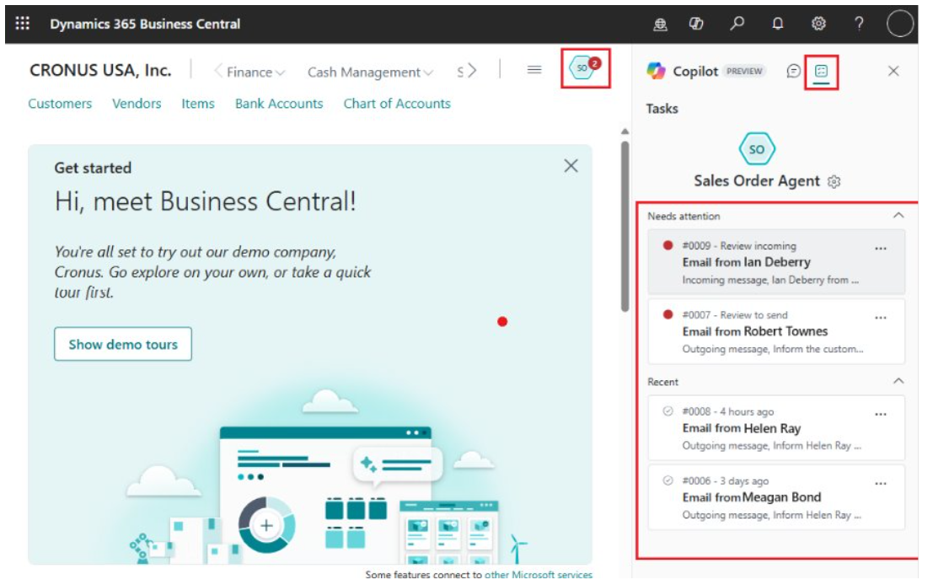

Slide 12
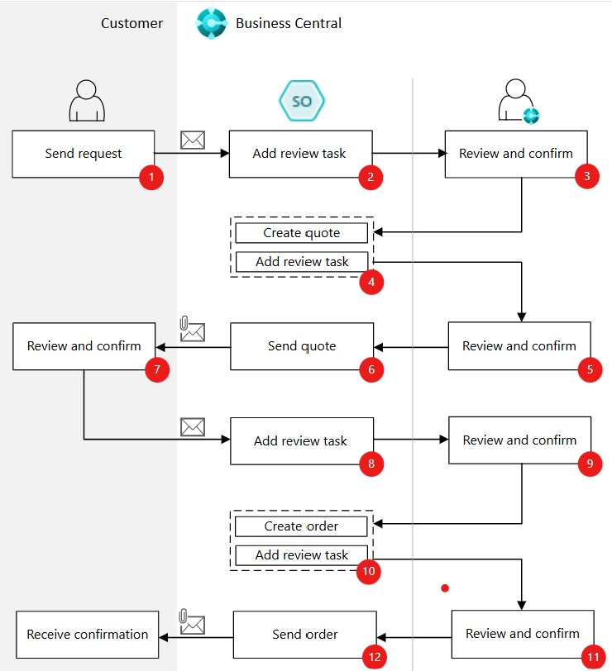

Slide 13
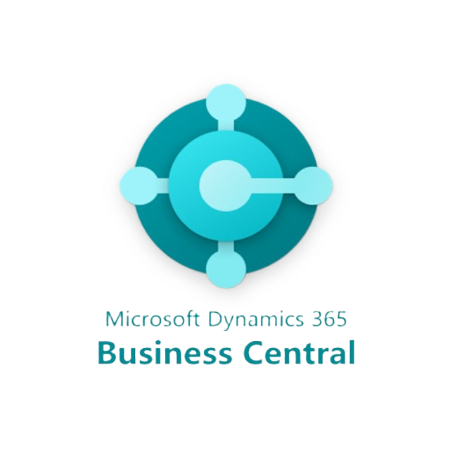
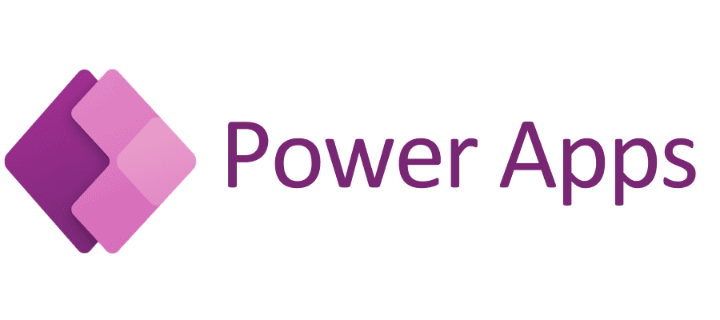
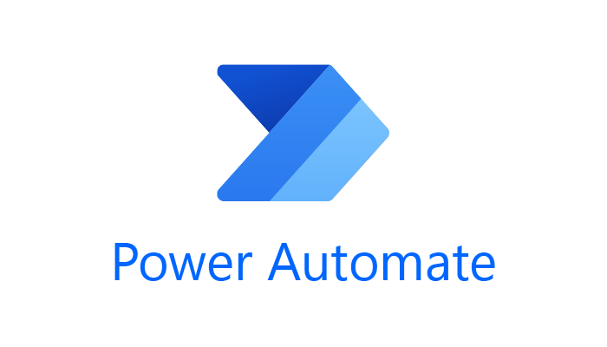
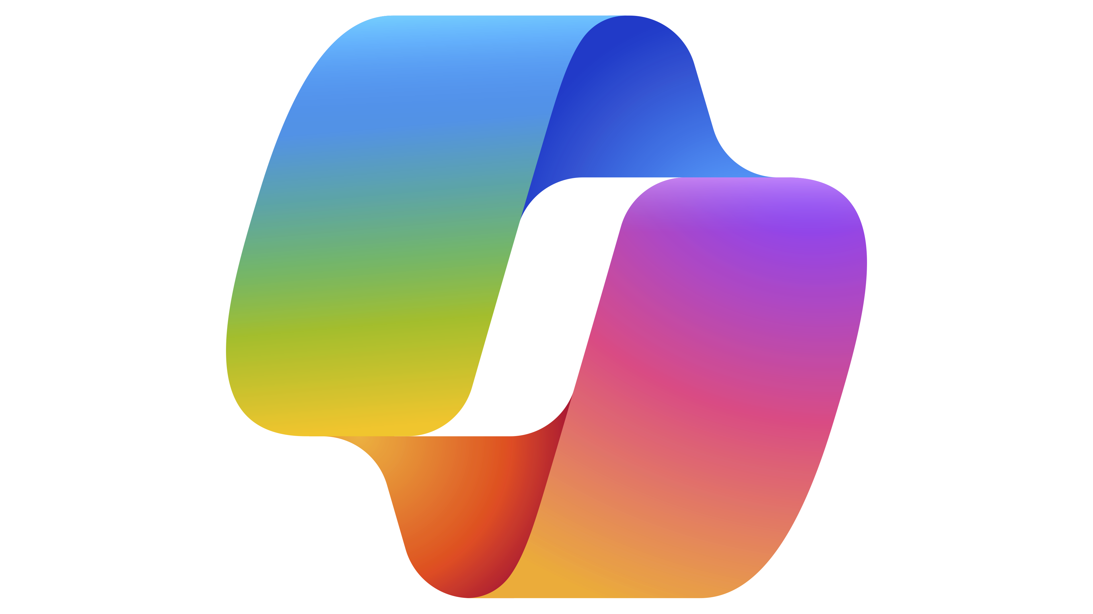

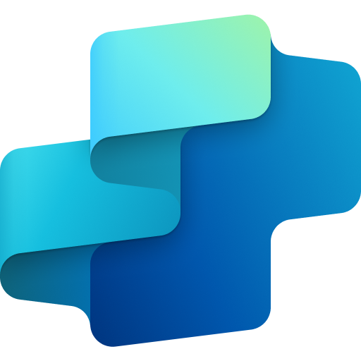

POWER PLATFORM
Copilot
Copilot Studio
Azure AI Foundry

Slide 14
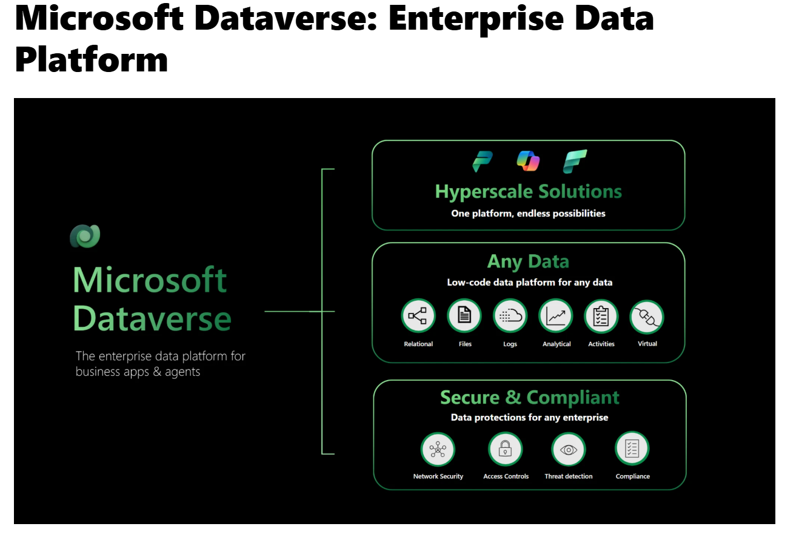

Slide 15
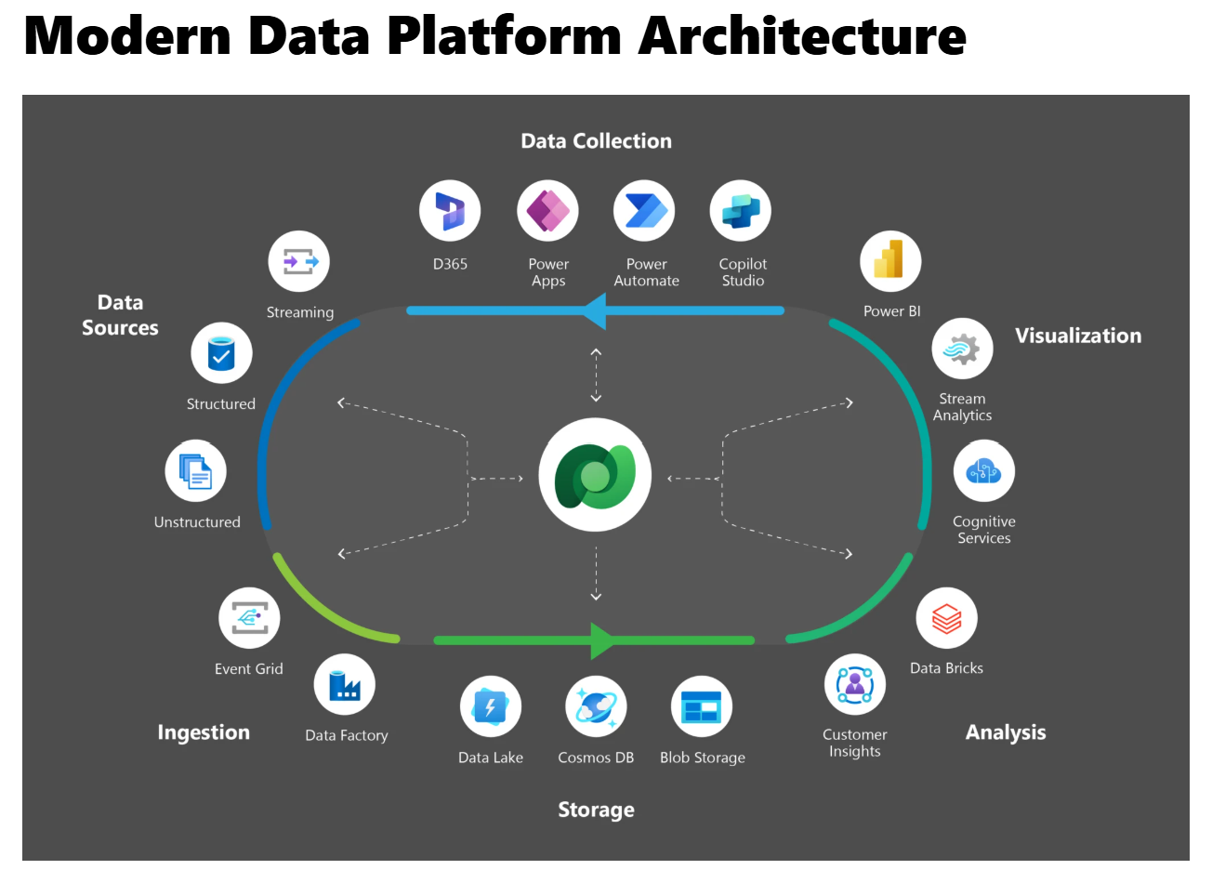

Slide 16
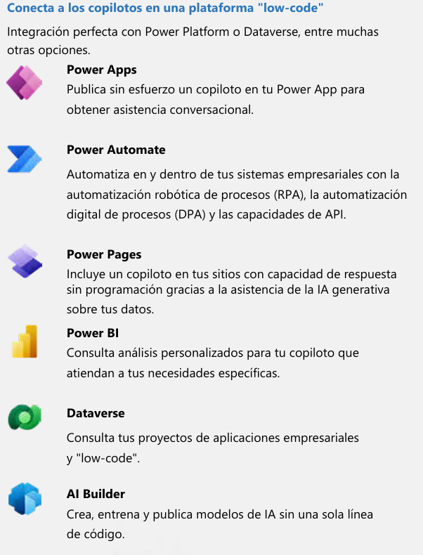
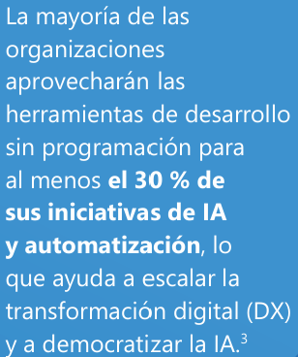

Slide 17

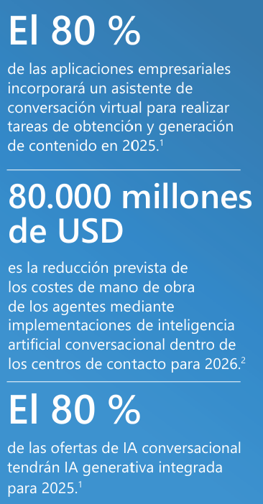
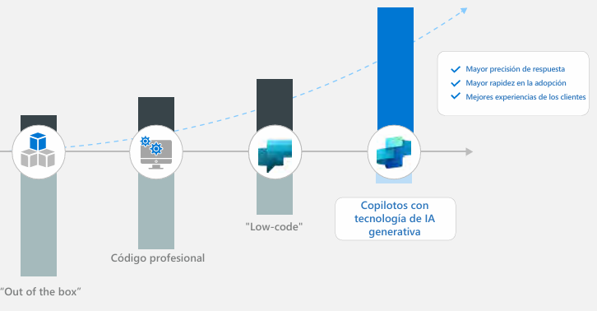
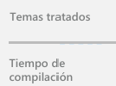

Slide 18
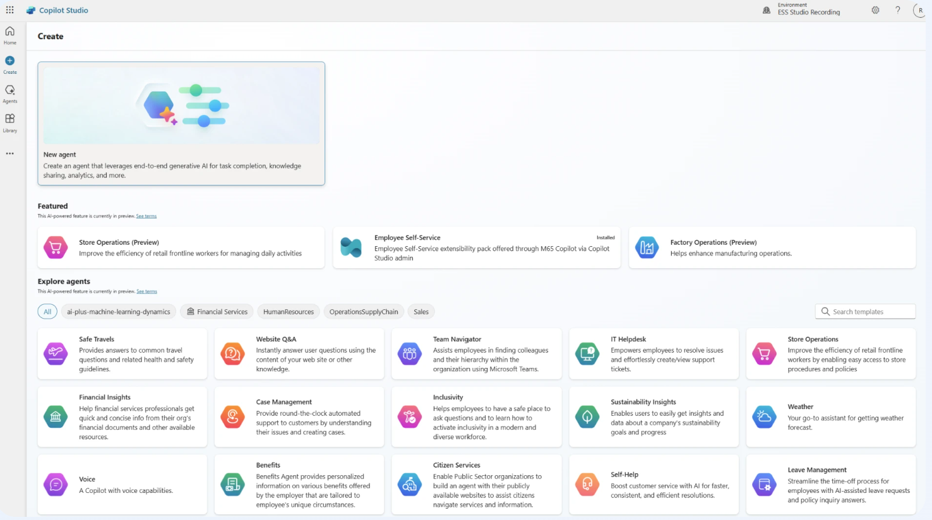

Slide 19
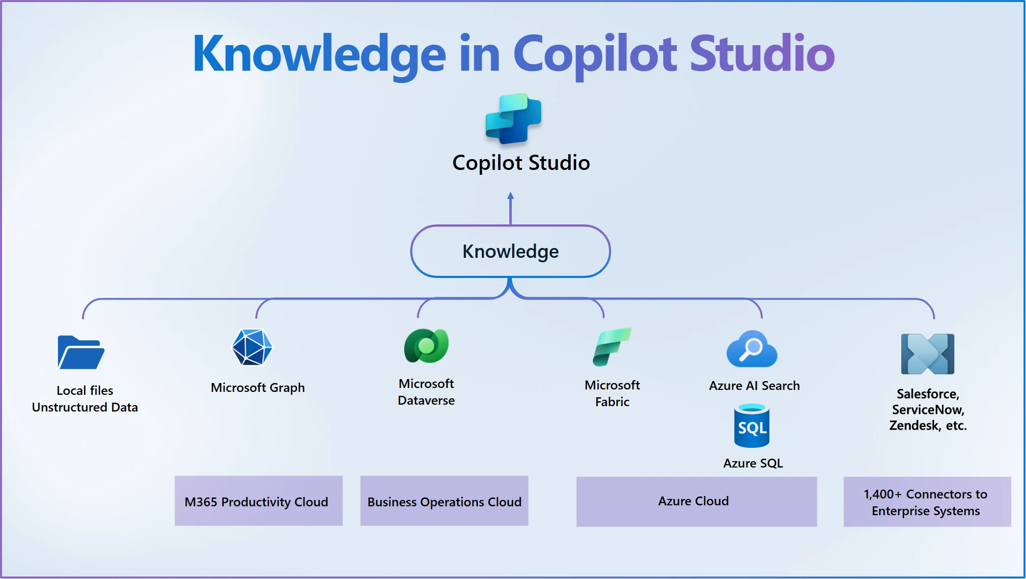
Notes:
Enterprise data is used to ground your agents in your organization’s knowledge, ensuring accurate and relevant information. This process is known as Retrieval Augmented Generation (RAG). This document provides an in-depth look at how your data from enterprise systems is transformed into knowledge through RAG on the data sources mentioned below:
Files – Using built-in semantic index of Copilot Studio
Enterprise Systems – Dataverse Tables and Azure SQL, Azure AI Search index, Salesforce, ServiceNow, and more) through 1,400+ Power Platform connectors or leveraging Microsoft 365 semantic index created by Microsoft Graph connections.

Slide 20
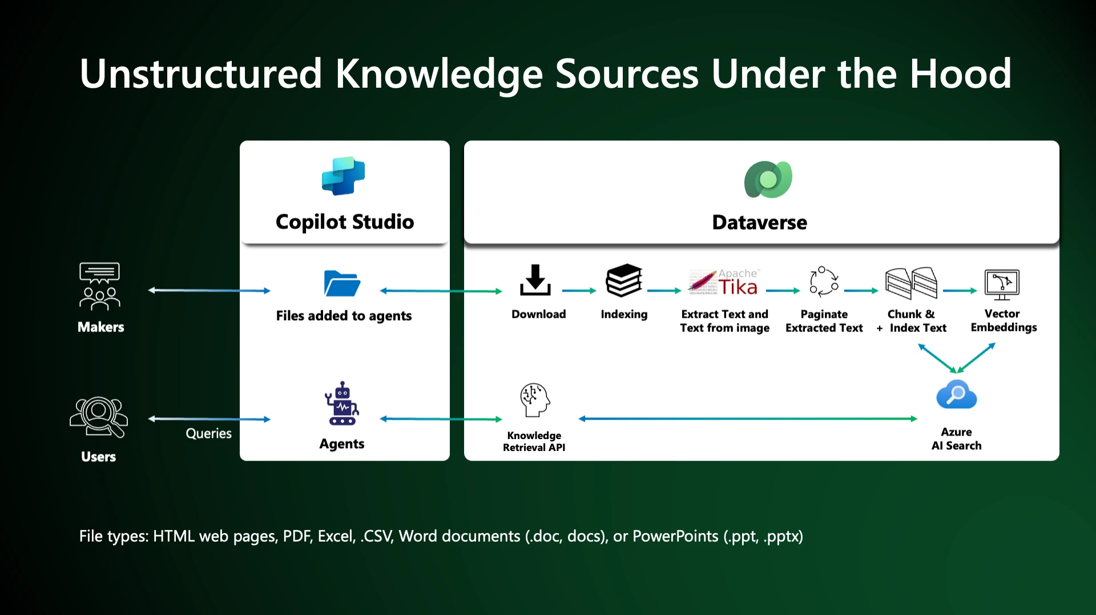
Notes:
Uploading files as knowledge helps makers enrich their agents with additional data, augmenting the LLM’s knowledge and grounding the agent in specific information provided by the maker. Makers can upload a variety of files (see types and limits here) which are semantically indexed as vector embeddings and then used as knowledge for agents. This knowledge used in agents can then be shared with authenticated and unauthenticated users of the agent.
To improve agent’s responses, uploaded files are chunked into smaller pieces for faster processing and vector-indexed to provide semantic match with the user query. They are stored automatically in a built-in store for the agent. Indexing time depends on the file size. When a user queries through an agent, the Copilot Studio orchestrator uses the relevant chunks that match the query, and then the LLM summarizes the top chunks.

Slide 21
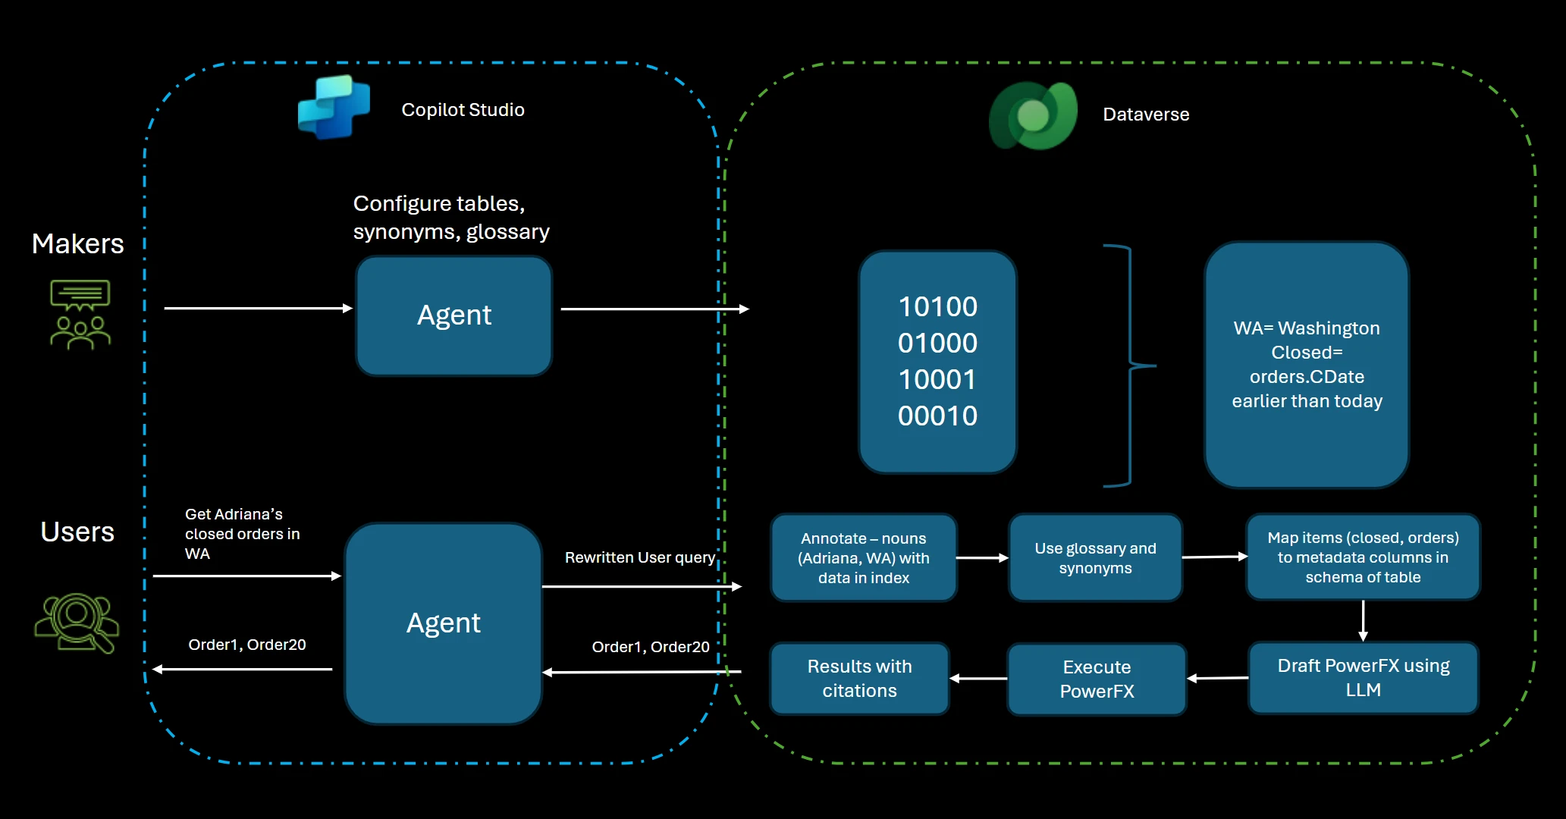
Notes:
Ensuring secure access to knowledge sources is critical for managing and harnessing enterprise data effectively. The data in the enterprise systems are accessed in the context of the end user and the end user always get to view the current data in the tables, based on the security roles assigned to them. Also, when a modification is made to the underlying data in these tables, by any application, user or the agent, these changes are reflected in real time to the next query from the agent!
Enterprise sources such as Dataverse tables contain data from Dynamics 365 business applications (i.e. Sales, Marketing, Finance) and custom business data useful for LOB agents. Makers can use existing Dataverse tables or create new tables via Data Workspace to provide knowledge for agents. Such new tables can be populated from Excel files, SharePoint lists and external systems using Dataflows built on Power Query.
When Dataverse is used as Knowledge, the user’s query is translated into runtime query against Dataverse. The data and metadata in these tables are semantically indexed and vector embeddings help with linking the objects in the user query to schema elements and annotation of values. These annotations, along with synonyms and glossaries provided by the maker, determine the relevant columns to be used while generating a PowerFX query from the natural language. Synonyms and Glossaries are provided by the maker, inside Microsoft Copilot Studio while adding Dataverse tables to provide more business and organizational context to the models being used to fetch relevant knowledge. Thus, you can see why synonyms and glossaries play a big role in getting quality responses for queries from agent. At runtime, the rich Dataverse security model is enforced including table, row and column security. This means that the end-user will only be seeing the records which they have access to. The entire end to end process is illustrated below.

Slide 22
VIDEO

Slide 23

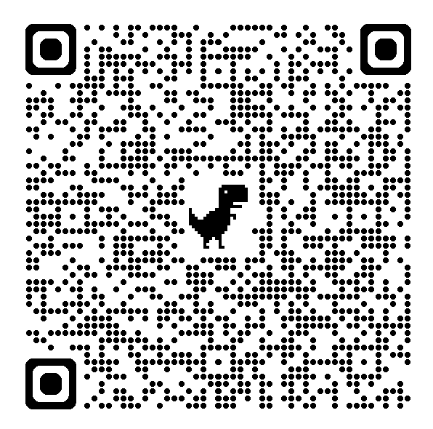
https://www.microsoft.com/en-us/microsoft-copilot/blog/copilot-studio/explore-agents-pre-built-for-you-in-microsoft-copilot-studio/

Slide 24

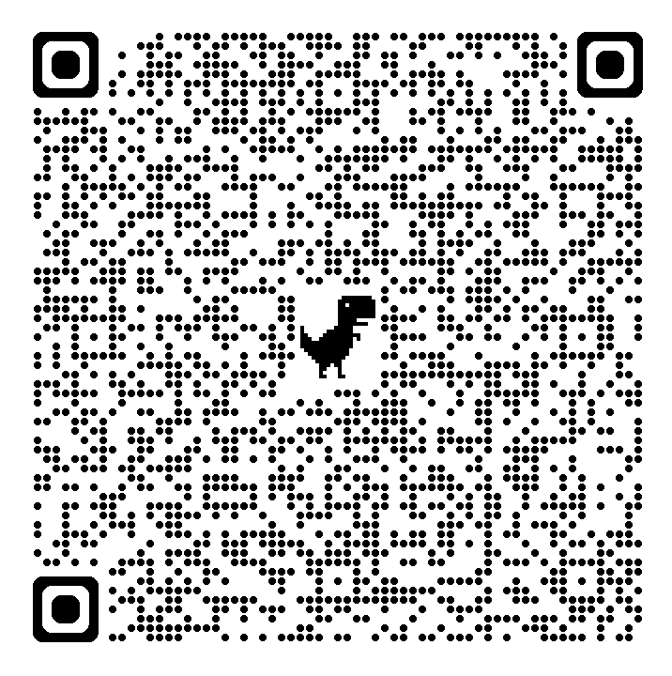

Slide 25
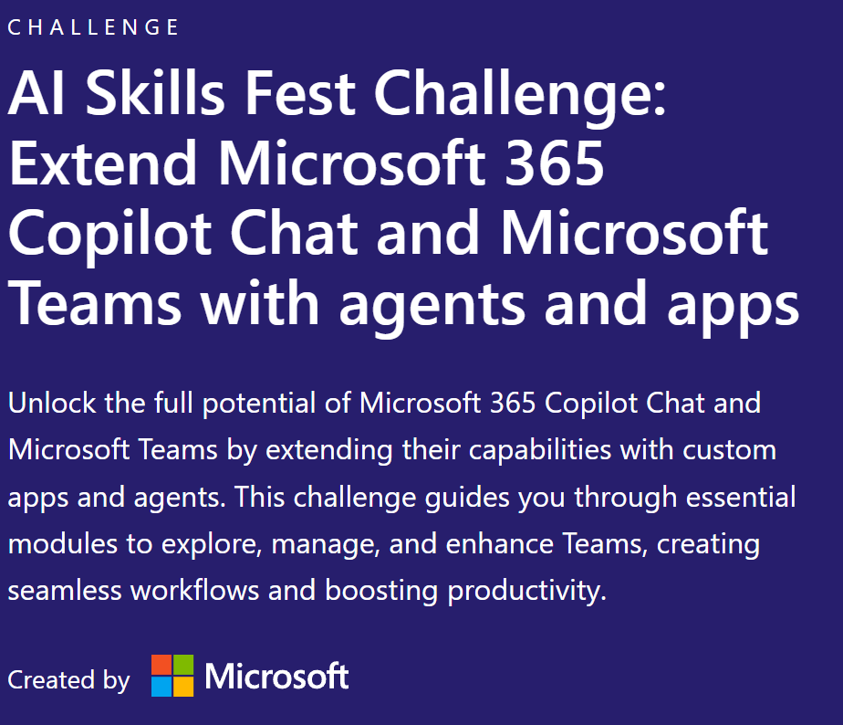
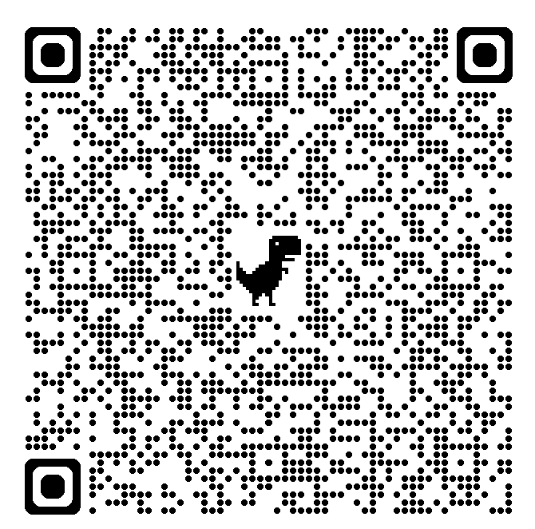

Slide 26









SI QUIERES ESTAR AL DÍA EN IA/COPILOT:
Magda Teruel
Toni Granell
David Hurtado
Ramón Rautenstrauch

Slide 27









SI QUIERES ESTAR AL DÍA EN DYNAMICS 365 BUSINESS CENTRAL:
Yun Zhu
Business Central YouTube
Stefano Demiliani
Alejandro Adelantado

Slide 28

¡¡¡¡GRACIAS!!!!
Toni Granell
https://www.linkedin.com/in/tgranell/
Ramón Rautenstrauch
https://www.linkedin.com/in/ramonrautenstrauch/
https://www.consultor365.com/

